Slide 1

Part 4 – Generative AI with the Hugging Face Ecosystem
Quang Duong

Slide 2
What we will obtain
Introduction to Hugging Face
Hugging Face Hubs
Models
Datasets
Spaces
Hugging Face Libraries
Transformers
Datasets,
Evaluate, …
Practical guides with Hugging Face
Fine-Tuning a pre-trained Language Model with Hugging Face
End-to-End Fine-Tuning Example
Sharing Your Model

Slide 3
Introduction to Hugging Face

Slide 4
Introduction to Hugging Face
NLP landscape since the arrival of Transformer model
Why Hugging Face
Hugging Face's ecosystem

Slide 5
NLP since Transformer's Arrival
BERT, DistilBERT, RoBERTa, ELECTRA, …
Encoder
NLP tasks
Text classification
Text generation, Translation
Question Answering
Named Entity Recognition (NLP)
Summarization
…
Transformer
GPTs, Llama 2, Mistral, …
Decoder
Encoder
Decoder
Encoder
T5, BART, …
Decoder
Transformer-based models

Slide 6


Why Hugging Face ?
NLP before Hugging Face
NLP with Hugging Face
Non standardized code implementation
Requiring days of engineering to adapt to a new use cases
Standardized interface to a wide range of transformer models
Code and tools to easily adapt the models to new use cases

Slide 7
Hugging Face Ecosystem

Slide 8
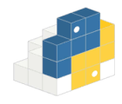
Hugging Face's Ecosystem
The collaboration platform for the machine learning community
https://huggingface.co
Libraries
Hub
Transformers
Datasets
…
Models
(>600K)
Datasets
(>150K)
API
Tokenizers
Accelerate
Spaces
(>50K app demos)

Slide 9
Hugging Face Hubs

Slide 10
Hugging Face Hubs
Models
Where you can download/upload an open-source model
Datasets
Where you can download/upload an open-source dataset
Spaces
Where you can inspire applications built upon open-source models and datasets under a light web-application interface with Streamlit or Gradio

Slide 11
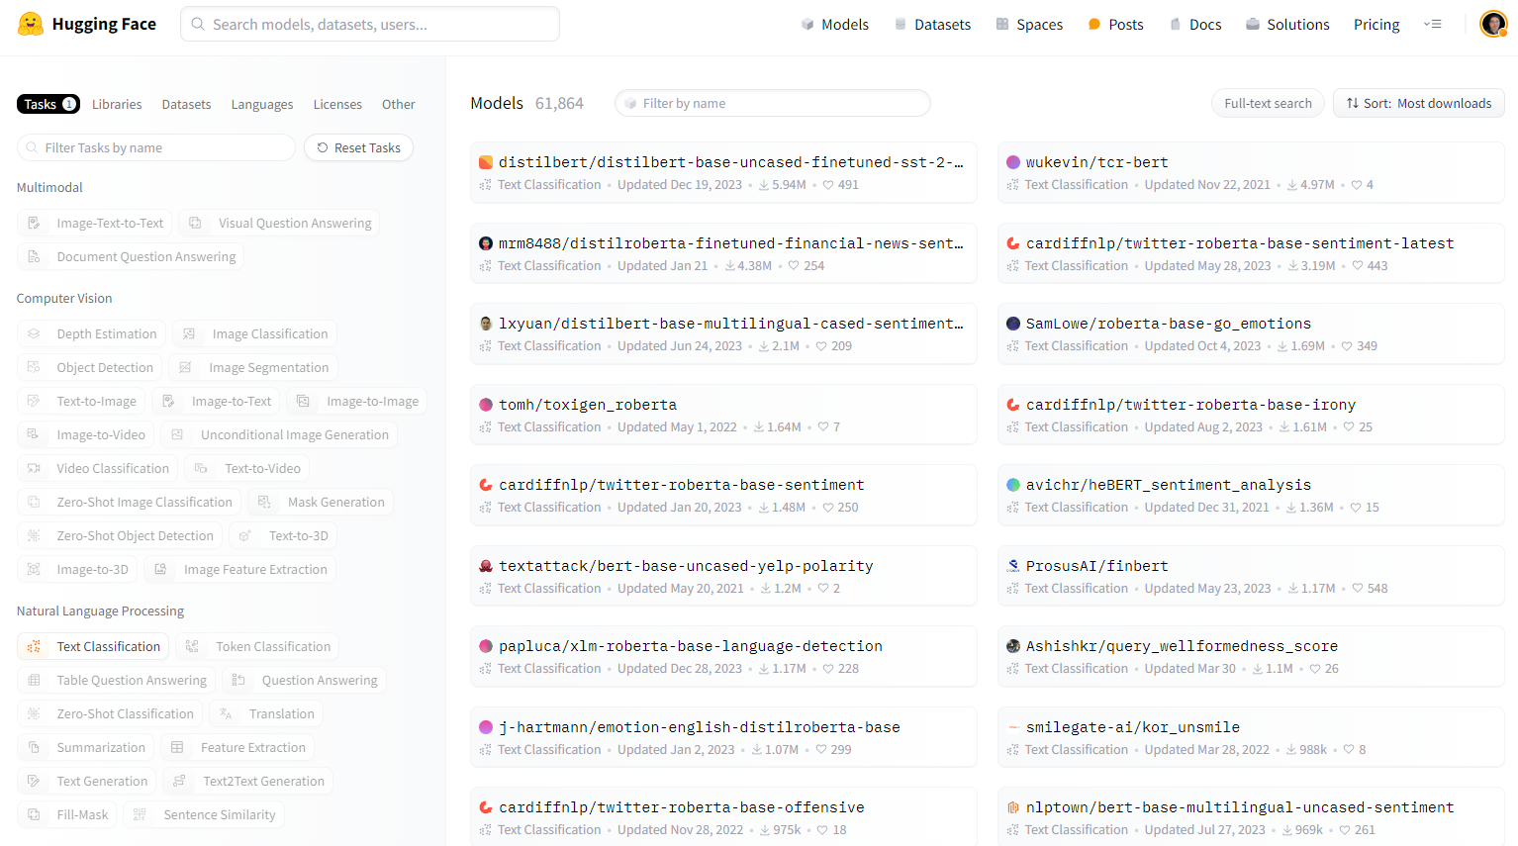
Hugging Face Hubs | Models

Slide 12
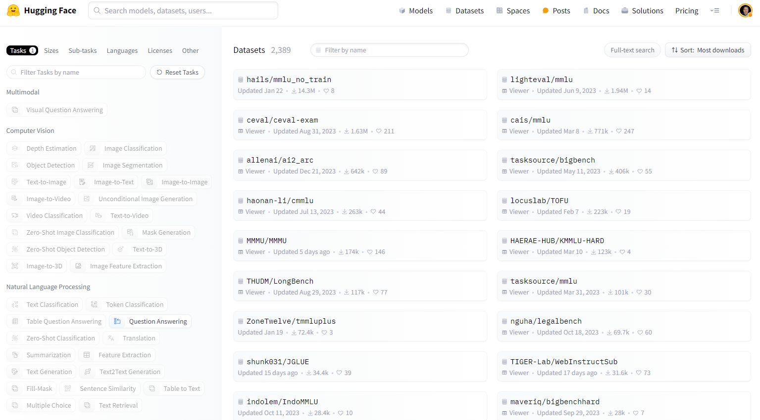
Hugging Face Hubs | Datasets

Slide 13
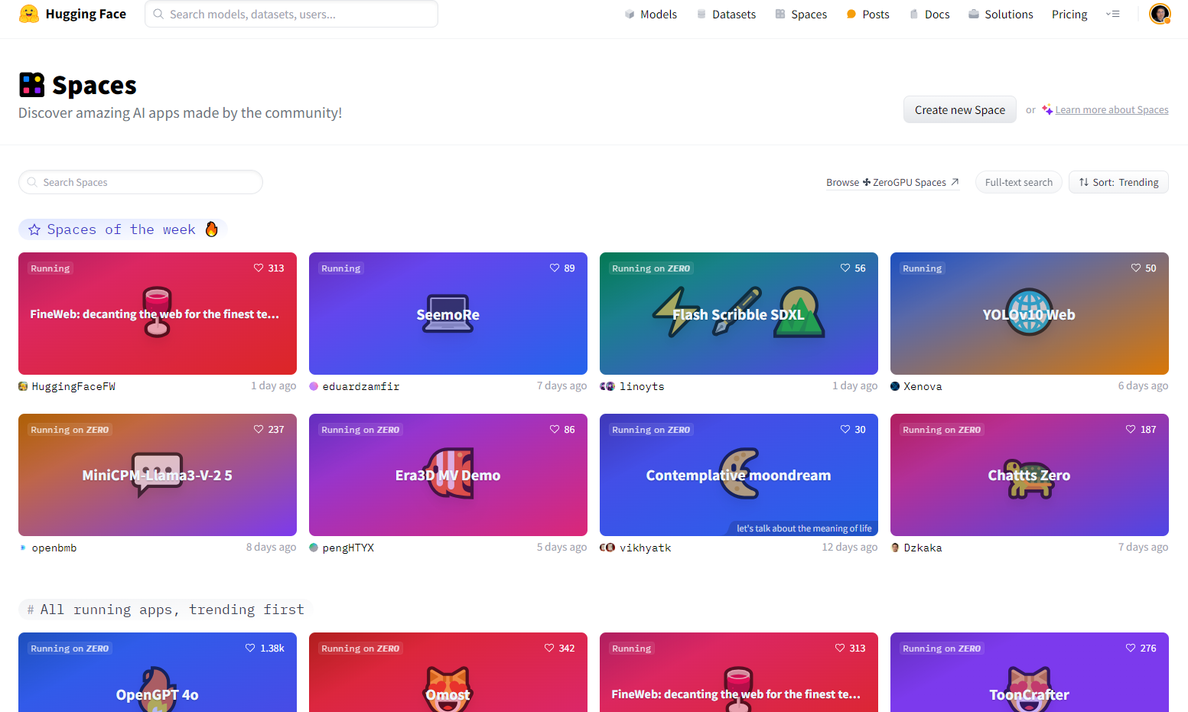
Hugging Face Hubs | Spaces

Slide 14
Hugging Face Libraries

Slide 15
Hugging Face Libraries
For models
Transformers
For datasets
Datasets
For evaluation
Evaluate
And many more
Accelerate, PEFT, etc.

Slide 16
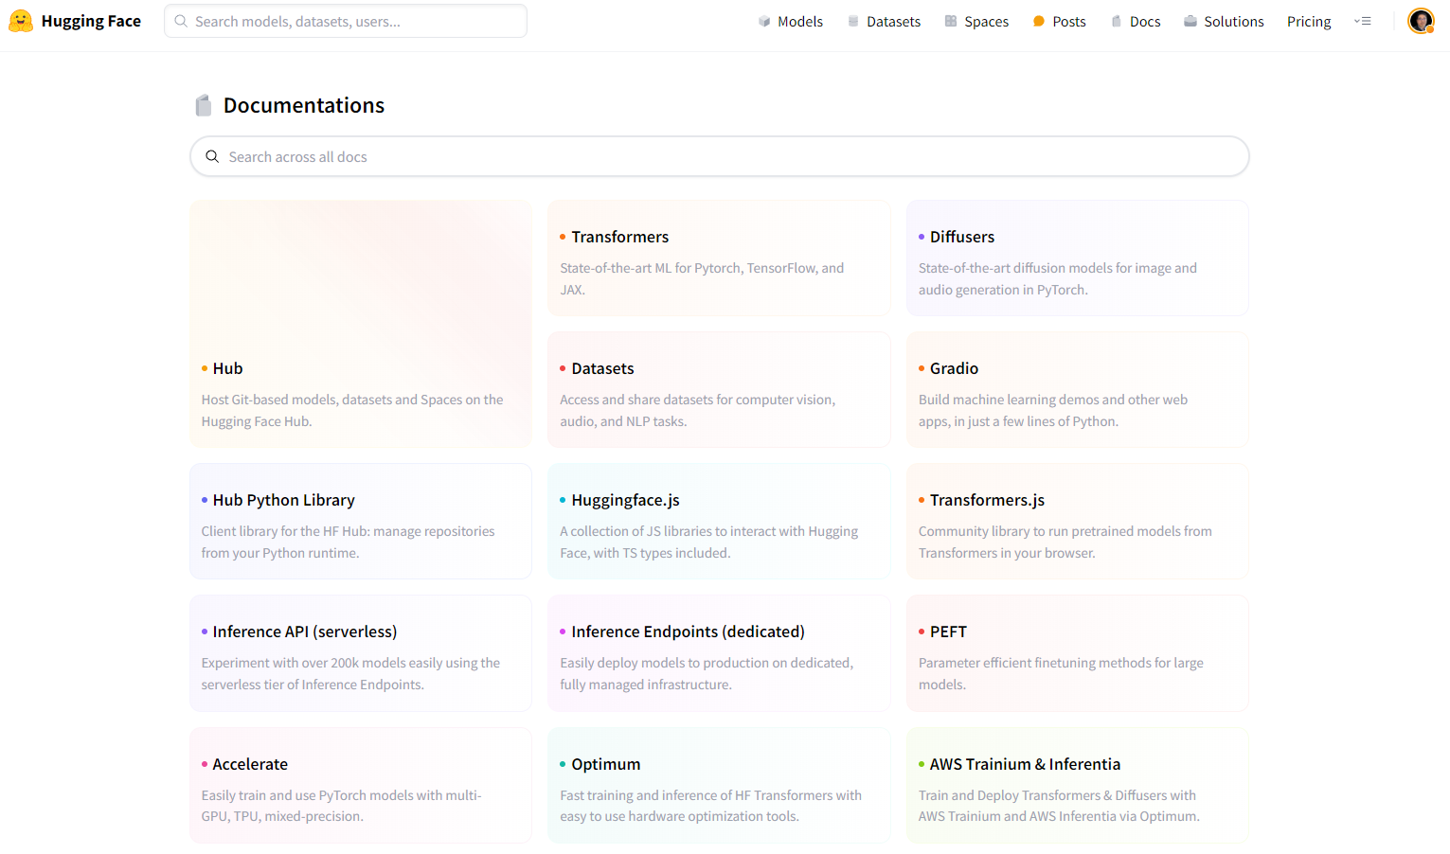
Hugging Face Docs

Slide 17
Transformers

Slide 18

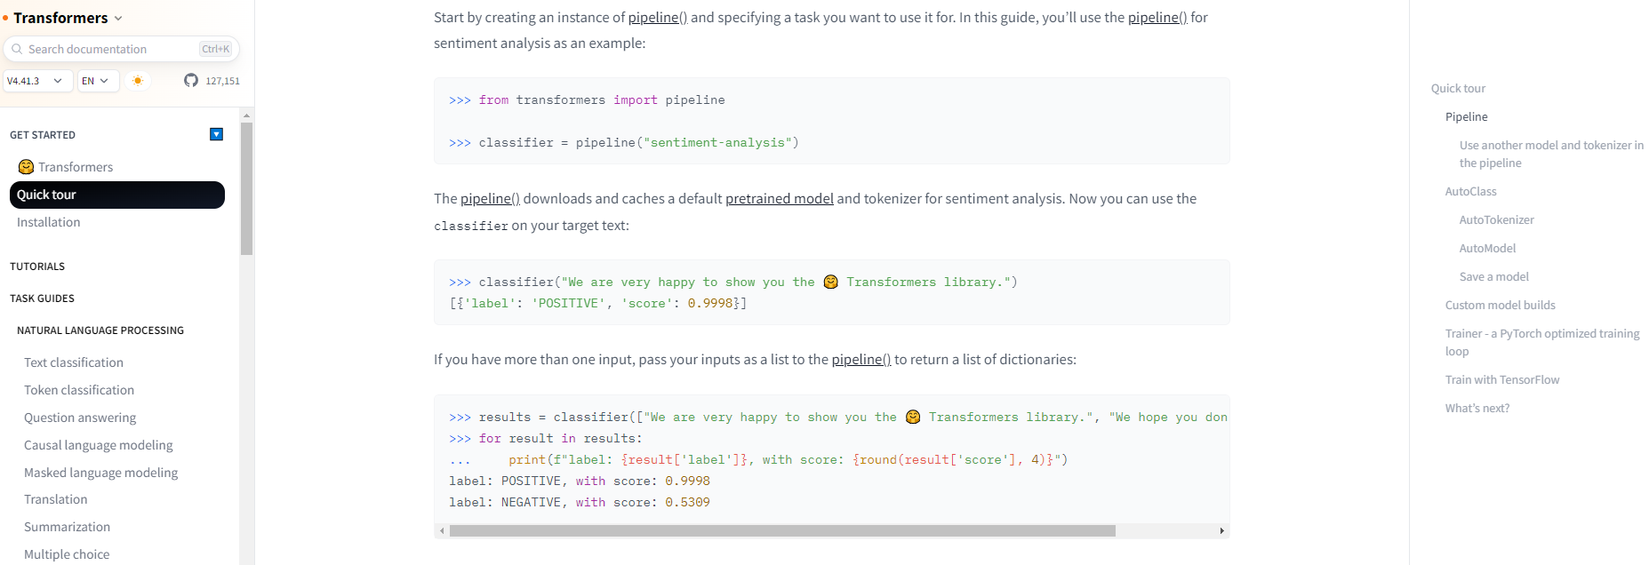
Transformers

Slide 19

Transformers
# Import necessary libraries from Hugging Face's transformers
from transformers import AutoTokenizer, AutoModelForSequenceClassification, pipeline
# Define the model name, e.g. a pre-trained BERT model for multilingual sentiment analysis
model_name = "nlptown/bert-base-multilingual-uncased-sentiment"
# Load the pre-trained model
model = AutoModelForSequenceClassification.from_pretrained(model_name)
# Load the pre-trained tokenizer associated with the model
tokenizer = AutoTokenizer.from_pretrained(model_name)
# Create a pipeline for sentiment analysis, using the specified model and tokenizer
classifier = pipeline("sentiment-analysis", model=model, tokenizer=tokenizer)
# Use the classifier to analyze the sentiment of a text string
classifier("We are very happy to show you the 🤗 Transformers library.")
Simplicity
A standardized interface to a wide range of transformer models
Adaptability
Implementing code and tools to adapt transformer models to new use cases
Deep learning frameworks
PyTorch, TensorFlow, and JAX.
Easily switch between them
Task-specific heads
Easily fine-tune transformers on downstream tasks, such as text classification, summarization, name entity recognition, question answering, etc.

Slide 20
Datasets

Slide 21
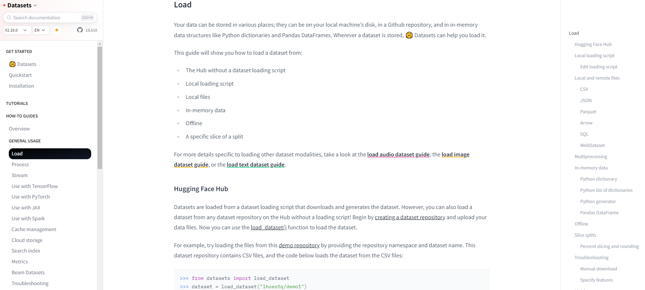
Datasets

Slide 22
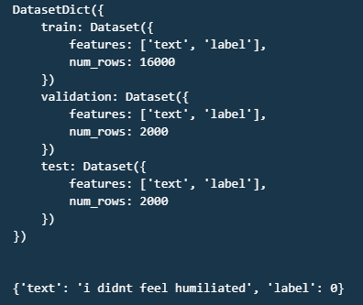
Datasets
# Import the load_dataset function from the datasets library
from datasets import load_dataset
# Define the name of the dataset we want to load. In this case, it's the "emotion" dataset
dataset_name = "emotion"
# Use the load_dataset function to load the specified dataset
dataset = load_dataset(dataset_name)
# Print the loaded dataset
print(dataset)
print("\n")
# Print the first sample from the 'train' split of the dataset
print(dataset['train'][0])
Standardized dataset interface
Standardized interface for thousands of datasets that can be found on the Hub
Smart caching
Do not have to redo the reprocessing each time running code
Memory mapping
Store the contents of a file in virtual memory and enable multiple processes to modify a file more efficiently
Panda, Numpy friendly
Be interoperable with popular frameworks like Pandas and NumPy

Slide 23
Evaluate

Slide 24
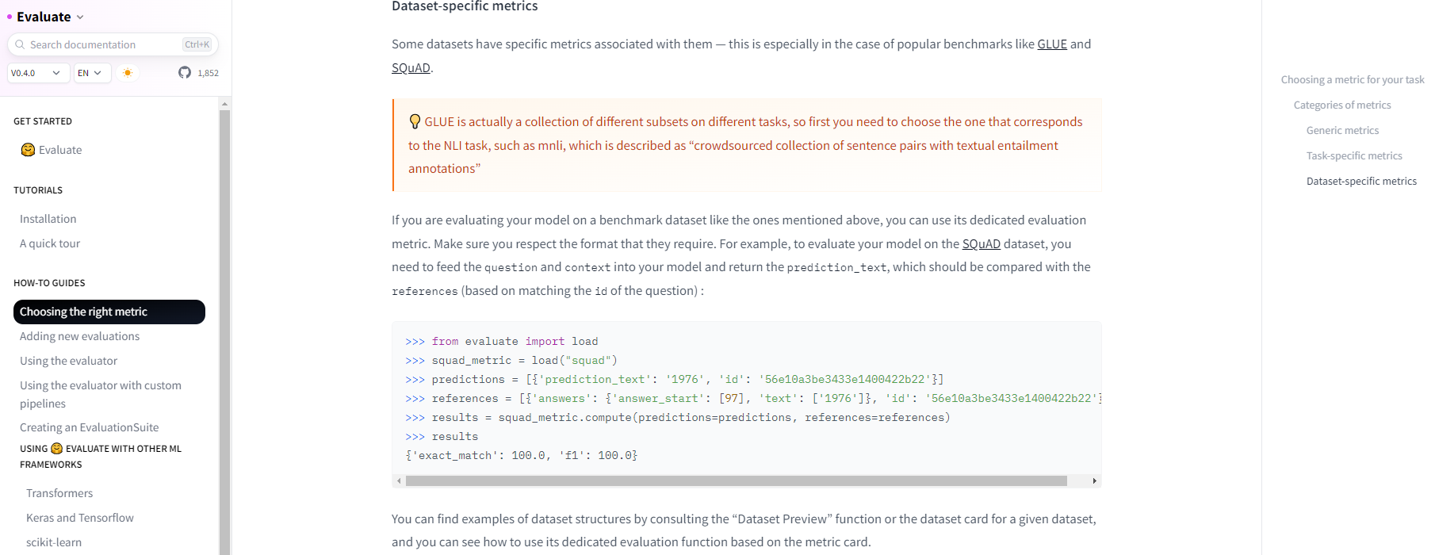
Evaluate

Slide 25

Evaluate
# Import the load function from the evaluate module
from evaluate import load
# Load the SQuAD (Stanford Question Answering Dataset) metric
squad_metric = load("squad")
# Define the predictions.
predictions = [{'prediction_text': 2024', 'id': '12e13ze1r13e1t3156'}]
# Define the references
references = [{'answers': {'answer_start': [97], 'text': [2024']}, 'id': '12e13ze1r13e1t3156'}]
# Compute the metric for the given predictions and references
results = squad_metric.compute(predictions=predictions, references=references)
# Print the results
results
Evaluate models in a consistent and reproducible way
On local machine or in a distributed training setup
Access to a wide range of evaluation tools
Metrics
Comparison
Measurement

Slide 26
Fine-tuning a Pre-Trained Language Model with Hugging Face

Slide 27
Fine-tuning a Pre-Trained LM with
Datasets
Transformers
Load and process datasets
Load pretrained model from Transformer Hub
Tokenize input texts
Fine-tuning
Transformers: train & infer
No
Evaluation
Evaluate: load metrics & evaluate model
NLP tasks
Text classification
Text generation, Translation
Question Answering
Named Entity Recognition (NLP)
Summarization
Ok
Fine-tuned Transformer models

Slide 28
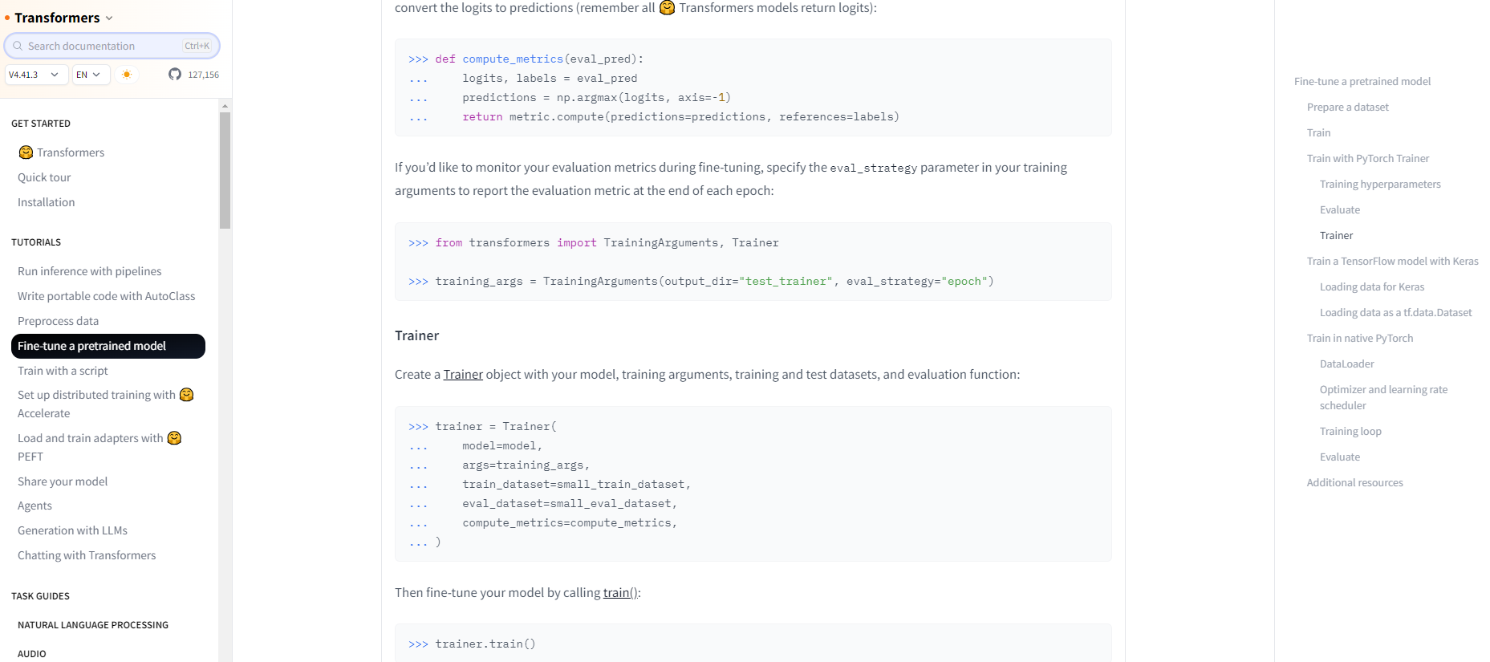
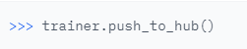
Fine-tuning a Pre-Trained LM with

Slide 29
End-to-End Fine-Tuning Example
Our use-case
Task
Spam classification for Email
Dataset
"tanquangduong/spam-detection-dataset-splits"
Pre-trained language model
"distilbert-base-uncased"
Push to hub
True

Slide 30
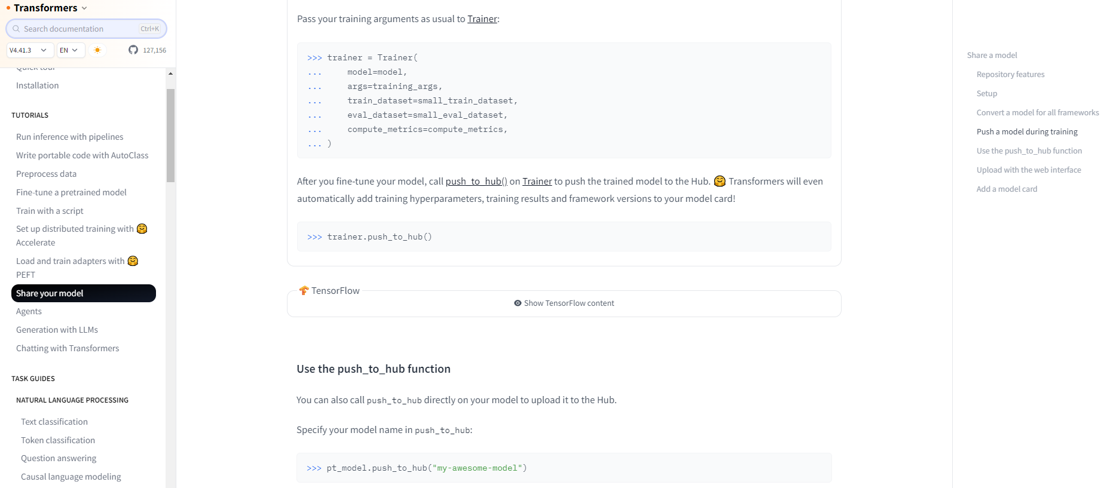
Sharing your model

Slide 31
What We Have Learned

Slide 32
In summary
A guide to Hugging Face's ecosystem
Hubs: models, datasets, spaces
Libraries: transformers, datasets, evaluate
How to get the most from Hugging Face's Docs
Fine-tuning a pre-trained language model for specific NLP tasks
Leverage Hugging Face ecosystem
End-to-end fine-tuning example
Sharing your model with the community

